Slide 1
Legal & Professional issues
Paul Bourke
Paul.Bourke@dit.ie
Assessment: CA 100%
4 CAs: In Class Tests

Slide 2
CA Dates (provisional)
In-class tests
Week Weighting
3 20%
6 25%
9 25%
12 30%
As dates of assessments may change, it is incumbent on students to check for updates.
Certification:
Where a student cannot be available for an assessment due to medical or other extenuating factors, then proper certification of these factors is required from the student. Where certification is not supplied, the student will received a zero mark for the assessment in question. Students may only avail of this process for a a maximum of one class test. Any further relief will only be on a discretion basis.

Slide 3
Website
(Note: Logout of any google accounts first)
https://sites.google.com/site/dt228lawsite/
Login: dt228law
Password: contract

Slide 4
Introduction to Law

Slide 5
The theme will cover:
historical development of law
nature of law
structure of law
sources of law

Slide 6
Common Law

Slide 7
modern Irish Law
Roots in English Feudal law
introduced to England by William the Conqueror
‘Curia Regis’ – King’s Court (Tenants in Chief)
  structure of administration
  based on existing local laws
  imposed his feudal system of ownership and control on top
  standardised and shaped a "Common Law".
Common Law:
  the body of law developed by the king’s courts was common to the whole realm.
  found, not in the customs of ancient England, but in the recorded decisions of the courts
Later in Ireland,
  Irish ways and customs were disregarded
  Common Law of England superseded this

Slide 8
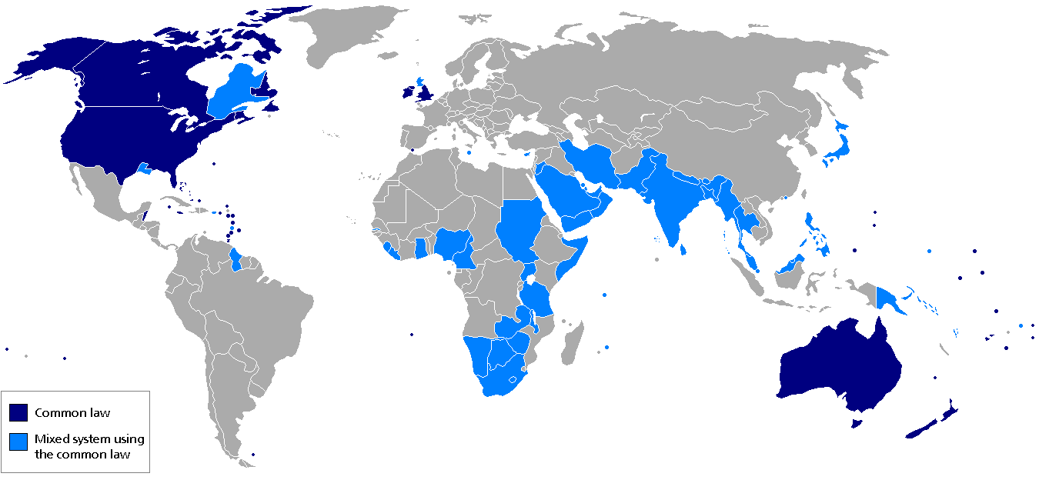
Common Law Jurisdictions

Slide 9
Reception of:
Legislation & Common Law
Article 50 of BUNREACHT NA hÉIREANN
Subject to this Constitution and to the extent to which they are not inconsistent therewith, the laws in force in Saorstát Éireann immediately prior to the date of the coming into operation of this Constitution shall continue to be of full force and effect until the same or any of them shall have been repealed or amended by enactment of the Oireachtas.

Slide 10
LEGAL ERAS IN ENGLAND IRELAND
 | England | Ireland
Millennia BC | Celtic Ways and Celtic Laws | Celtic Ways and Brehon Laws
1st Millennium | Roman Rule to Dark Ages and Viking Age | Brehon Laws and Christianity
2nd Millennium | Norman Feudal Law evolves into the Common Law System | Centuries of Struggle result in English Law replacing Brehon Laws
3rd Millennium | Global Economy brings Globalisation of Law | Globalisation of Law

Slide 11
Common Law

Slide 12
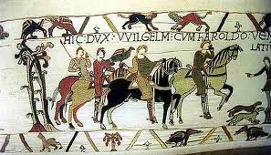
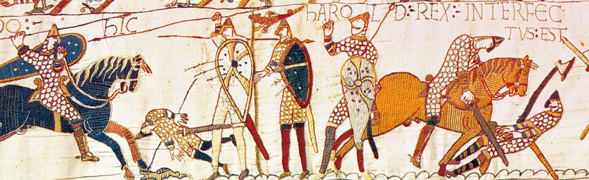
modern Irish Law
Roots in English Feudal law
introduced to England by William the Conqueror

Slide 13
William the Conqueror
‘Curia Regis’ – King’s Court (Tenants in Chief)
  structure of administration
  based on existing local laws
  imposed his feudal system of ownership and control on top
  standardised and shaped a "Common Law".
Common Law:
  the body of law developed by the king’s courts was common to the whole realm.
  found, not in the customs of ancient England, but in the recorded decisions of the courts
Later in Ireland,
  Irish ways and customs were disregarded
  Common Law of England superseded this

Slide 14
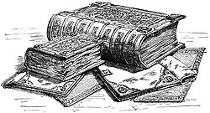
Domesday Book

Slide 15
First Millennium: England
Roman conquest by Caesar around 55 BC brought
  peace and prosperity
  the concept of equality for Roman citizen
500 AD Roman army leave
  chaos ensued.
  invaded by the Angles and Saxons.
  Roman Law and learning left no trace.
Invaders’ laws varied across the country
  Crude concepts such as trial by combat, ordeal or immersion,
  compurgation (repeating an oath word-perfect without stumbling).
  Tithing: used to force communities to police themselves
Later Christian missionaries from Ireland/the Continent
  gradually restored Christianity and literacy.
Viking invasions: produce further period of chaos

Slide 16
English Feudal Law
William ruled through land ownership
He owned all England as king
He granted large segments to his great vassals (Barons and Lords)
Subject to Service, Fealty and Homage
  Otherwise forfeited - Coroner
They sub-granted to mesne Lords, etc.
Land Occupiers: serfs: no title: tenants at will
Land granted to Bishops: different duties.

Slide 17
Feudal Courts
Curia Regis
  assisted king with the legislative, administrative, judicial process
  Later evolved into courts
  Specialisation through Divisions
  Landlords held Manorial Courts
  Existing local courts were continued
Later Great vassals called to parley re taxes:
  Parliament

Slide 18
Feudal Supervision of Local Courts
Sheriffs supervised Manorial Courts
Justices of the Peace supervised Local Courts
Soldiers assisted Sheriffs and Justices
Enforcement By tithing:
  dividing the population into groups of 10.
  a serious offence was committed by any member of the tithe, the entire tithe was punished.
  the population policed themselves.

Slide 19
Evolution: in Common Law
William made few new laws/decrees
Courts’ function: to enforce existing law
Uniformity achieved
  through central control of the court sys. by sheriffs and justices
  the centralised sitting of the principal courts.
Stare Decisis (=Precedent):
  a matter was decided by the king's court,
  Meant all similar future cases would be decided in the same way
Therefore Common Law:
  is found in decisions of the judges
  not in local customs
Ancient custom is not usually a source of law today
  rare exceptions include “the Foyle Fisheries” case

Slide 20
Common Law Jurisdictions

Slide 21
Parliament

Slide 22
Constitutional Developments
Parliament
Norman kings continually at war in Europe.
  King had to constantly look to their barons for funds.
  King called meetings of the great vassals (barons, lords and bishops) to parley ("parler")
  In order to vote money transfers to the king.
Later parliament began to present petitions
  “Bills” in return for voting for money
“Bills” became Acts (or Statutes) of Parliament
  legally binding due to the king's signature.

Slide 23
Magna Carta, 1215
In 1215 a group of Barons waylaid King John at Runnymede,
  forced him to sign a document, the Magna Carta
curtailed the arbitrary powers of the king
Some Irish barons were involved
  William Marshall, Earl of Pembroke
  Norman-Irish were aware of how an Irish king's powers were curtailed under Brehon Law
King had to recognise the rights and liberties of the lords and barons, of the Church, and of free men (that is, land owners)
Introduced “Juries”:
  No freeman was to be convicted henceforth for any crime, except by the verdict of a jury of his peers

Slide 24
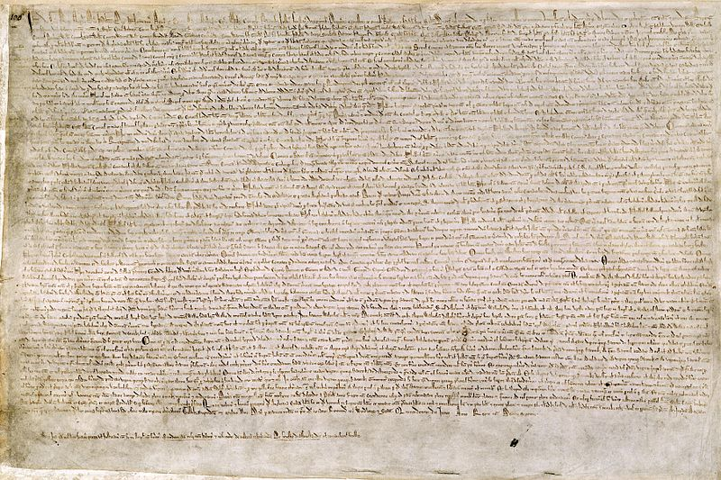

"The Great Charter of the Liberties of England, and of the Liberties of the Forest,”

Slide 25
Houses of Parliament
1265: City and Borough Reps were now called to parliament (Commons).
Lords and the Commons met separately
  origin of the House of Commons and the House of Lords.

Slide 26
Bill of Rights, 1689
Power shifts to Parliament
After the restoration of the Stuart kings, James II began to act in an arbitrary manner, ignoring parliament.
The parliamentarians removed him from the throne and offered the kingship to his son in law, William of Orange.
conditional on William's signing the Bill of Rights, which obliged him to call the parliament at least once every year to approve the king's proposed expenditure and the taxation of the realm.
Since then parliament has been the real power, the monarch's signature being a rubber stamp on the law.

Slide 27
Irish Experience

Slide 28
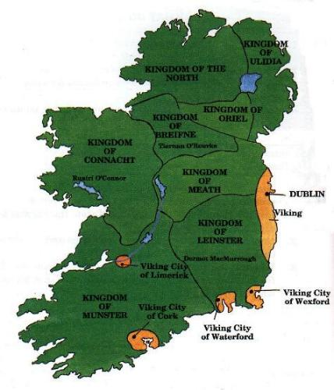
Pre-Norman Map of Ireland

Slide 29
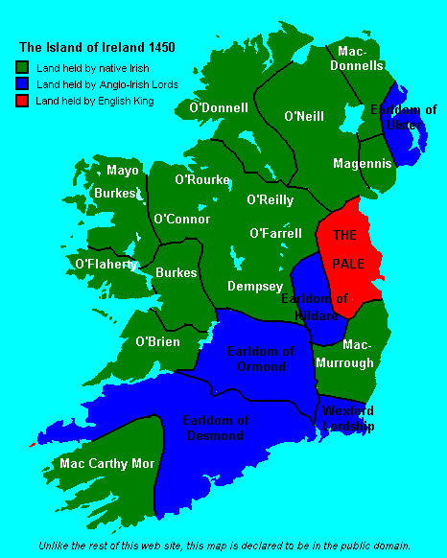
Ireland 1450

Slide 30
Celtic Europe
Ireland originally part of a Celtic world
  included northern Europe.
  a common culture, but no centralised state power
  a "warrior" culture, which valued bravery and fostered conflict
Territories not fixed - "wanderlust of the celt"
  Enclosed timber dwelling-houses in protective stone or earthen enclosures;
Hierarchical structure
  king/learned men/druids, at the top,
  slaves at the bottom;
Shared some legal concepts, if not entire legal systems;
  similar to concepts found in customary (tribal) laws in Africa, America and Asia;
  No prisons; wrong was redressed by monetary compensation;
  a debtor could be bonded to his creditor and sold to another, until the debt was repaid;
Was relatively wealthy, with high protein diet
  using salting and smoking as methods of preserving meat,
  cheese and butter-making as means of preserving dairy produce;
  Engaged in farming, (grain, cattle, sheep and dairy products), fishing, hunting, bee-keeping, metal and salt-mining, metal work (iron, bronze, gold and silver), clothes-making, (woolen, leather, furs) salting of meat and fish, cheese-making;
Did not have reading or writing;
  learning were memorised and passed orally from generation to generation;
Declined with Vercingetorix (Arverni tribe) (52 bc) defeat by Caesar.

Slide 31
Celtic Ireland BC
Legal system, known as the Brehon Laws
Laws in cryptic language,
  Triads: groups of three things or characteristics
  responsibility of the fili (poets, or learned people).
  Verse formed discourse format (Question and Answer).
  passed on word perfect from one generation to another.
  “There are three foundations of law and custom: order, justice, and peace.”
  “Three foundations of success: a silent mouth, a careful ear, and a fitting action.”
Lawyer spent up to 20 years learning these laws verbatim
Tara, in County Meath, was a ritual centre from Neolithic times (4,000 BC).
Whoever ruled Tara was considered High King of Ireland.
Feis: a triennial gathering was held in Tara,
  attended by people from all over Ireland,
  there were games, music
  a conference of the brehons.

Slide 32
Brehons = judges; had to know and apply the law.
King was subject to the Law.
Status: Kings = druids = fili
Next in structure:
  Brehons, medical specialists and harpists.
  Princes (landowners with a certain number of tenants)
  landowners and then free tenants
  client-tenants (who were advanced cattle as well as land),
  At the bottom unfree tenants and bonded servants.
All free men attended a king's council also defended the realm
Approx. 150 kingdoms in Ireland.
In return for protection
  Local kings paid tribute to regional and/or provincial kings,
  provincial kings paid tribute to a High King.

Slide 33
First Millennium, Ireland:
Christianity merged with Brehon Law
  Druids gradually replaced by Clergy
  Kings selection by Magic Rites replaced by election the dead king's kin
Clergy demanded punishment for crimes
  A Life for a Life
  Death penalty for Rape
  Mutilation for stealing
  Monogamy to replace Polygamy
Where Christian sexuality
  Required chastity outside of monogamous marriage
Brehon law allowed polygamy, divorce and trial marriages.
Sexual union (except by a prostitute) resulting in birth gave rise to rights and duties in law.
Levels of marriage,
  Highest: formal agreement for marriage between two propertied persons,
  Lowest: being a rape, placing obligations on the man
Bible v. Folklore:
  clergy tended to disregard the large body of learning and wisdom in folklore
  Relied on the interpretation of history, philosophy and politics found in the written Bible texts.
  After Colmcille: the clergy sponsored the recording in written form of much of the folklore and Brehon Laws

Slide 34
End of Tara (554 AD)
Implementation of "Life for Life” for protection of the lower orders
  as previously rich people often abused their positions,
  as the murder or rape persons of low honour-price only required payment a handful of silver to redeem themselves in law.
Manifest Function of this demand was to protect common people from abuse by wealthy people
Latent Function: As with any other law, it is the powerful who are best at turning the law to their own advantage.
High King: Diarmuid took advantage of the tentative change of law
  to put a disagreeable subject to death.
Saint Ruadhán (or Rodan) went to Tara with his followers in protest
  fasted against the king
  was believed he cursed Tara
  Diarmuid’s successor left Tara for good

Slide 35
Fall of Tara: consequences
Political instability/stalemate
High Kingship now based on balance of power
End of triennial Tara Feis
  No conferences of Brehons
  Little subsequent updates in Brehon Laws

Slide 36
Drom Ceat, 575 AD
Convention called to resolve conflict
Colmcille: defended Brehon Laws
  Canon Law: a guide to Christian conscience
  Brehon Law: practical solutions in Real World
Result:
  retention of the Brehon Laws.
  No further clergy's opposition to Brehon Laws

Slide 37
Conquest of Ireland: 12th Century
After claims by Henry II
Normans arrive
Introduced English feudal law
Upto 15th Century:
  English rule limited to the Pale
  Normans "as Irish as the Irish themselves"
16th - 17th Century: Conquest Completed
1607: English Law extended to all Ireland

Slide 38
Irish Experience
1170: Richard FitzGilbert (Strongbow)
1210: King John decrees English Law
  But confined to Pale
1310 Parliament of Ireland set up, had limited powers, being allowed to consider only bills presented by the king's representative.
1394: King Richard II est. King’s Bench Ct.
1556: Privy Council gave way to Brehon Law
1614: 5 circuits est. hearing Crim&Civ cases

Slide 39
Parliament in Ireland
  The Parliament of Ireland, set up around 1310, had limited powers, being allowed to consider only bills presented by the king's representative. In addition, the parliament of England held itself entitled to legislate for Ireland.

Slide 40
Poynings’ Law
An Irish Statue which declared that all English statues would carry in Ireland
Effect: Limited the power of Ir. Parliament
  Irish privy council decides Irish bills
  Later ratified by Crown
  Ir. Parliament impotent in effect
  Statute of Frauds 1677>>1695 in Ire.

Slide 41
English Supremacy
Dependency of Ireland Act 1719
  London has right to directly legislate in Ire.
Panic of American Ind. & Ir. Volenteers
  Grattan’s extracts Ir. Leg. Ind. thru
  Dependency of Ireland Act 1782
  Repeals both earlier act & Poynings’ law
1798: Rebellion
  1800: Act of Union passes in Dublin & London
  “United Kingdom of Great Britain and Ireland”

Slide 42
Modern Irish history
Jan 1919: SF members meet in Dublin
  Constituted themselves as Dail Eireann
  Drew up “Constitution of Dail Eireann”
  Promulgated
    Declaration of Independence
    Democratic prog. > reaffirm Proclamation 1916
British Parliament reacted
  Government of Ireland Act 1920
  Partition North/South
Dec. 1921: Anglo-Irish treaty signed
  Irish Free State (Soarstat Eireann), Dominion status

Slide 43
Constitution of Irish Free State
Passed in Oct. 1922
Innovative– organs of state/Fund. Freedoms
Yardstick for legitimacy of all other laws
Declared authority: God > People > Government
Did not create a new set of laws
  Declared old law existed until repealed
Some contentious issues
  Oath of Allegiance
  Office of Governor General
  References to Crown
Abdication of King Edward 1936 provides opportunity
  1937: Constitution of Ireland / Bunreacht na hEireann
1948: Republic of Ireland Act – removes External Affairs from Crown

Slide 44
Reception of:
Legislation & Common Law
Article 50 of BUNREACHT NA hÉIREANN
Subject to this Constitution and to the extent to which they are not inconsistent therewith, the laws in force in Saorstát Éireann immediately prior to the date of the coming into operation of this Constitution shall continue to be of full force and effect until the same or any of them shall have been repealed or amended by enactment of the Oireachtas.

Slide 45
Amendments to Constitution
1972: Member of EEC
Divorce
Abortion information
Bail law changes
Other EU treaties including next year:
  New EU Constitution
  Child laws
1996 McKenna v. Ireland:
  Led to establish Referendum Commission
1998 Belfast Agree. req. changes to Art. 2&3

Slide 46
Courts

Slide 47
Role of Courts
as a Source of Law
Case law is precedent
  which is to say that any instances where the same facts or similar facts have been applied to a rule (whether constitutional, statutory or an SI) in the past are used by subsequent courts to clarify the rule to be followed in another case.
As a result case law tends to be more reliable, or at least not changed without good reason
Based to the rule of stare decisis, a Latin expression meaning binding precedent, which requires a court to apply a previous case decision in deciding the law in a present situation.
The doctrine of binding precedent is based on the premise that like cases should be decided in the same way, as part of the doctrine of legal certainty
The doctrine of binding precedent means that the ratio decidendi (reason for deciding or rule of law) from a higher court is binding on a lower court
The ratio decidendi is only binding to the extent that it is relevant for the claims being determined, or in point.
Obiter dictum are comments made by members of the judiciary in determining a case but which are not relevant for the claims being determined in that case, and which are for that reason not binding on another court.

Slide 48
persuasive precedent
There is also persuasive precedent, where a court though not bound may still follow a decision from another court.
courts will also look further afield for persuasive authority – and therefore decisions in the United States, Australia, France, Netherlands, Germany, New Zealand, South Africa and Canada, to name a few, will be relevant

Slide 49
Interpreting Legislation
Legislation is intended to be clear and unambiguous.
However, it is possible that the form of expression used in legislation is not clear – and in these circumstances, the statute in question is capable of being interpreted in different ways.
There are a number of techniques used by the courts to interpret statutes.

Slide 50
Rules for interpretation
Ejusdem generis –"of the same kind, class, or nature" –
  where a statute contains general wording after a list of specific items, then the generality of those words should be read as being limited by the items listed to being items like those specifically listed.
Expressio unius est exclusio alterius – "expression of one thing is the exclusion of another" –
  which means that including one specific item in a list or specifying one thing indicates that the legislature intended to exclude all others. This can only operate where words are not illustrative only.
Noscitur a sociis – "it is known from its associates"
  which means that ambiguous words and phrases can be given a meaning from surrounding words and context.
Rule of Lenity
  an approach which finds that criminal statutes should be construed narrowly.

Slide 51
Over time the courts have adopted different approaches to interpreting statutes
  current fashion: to interpret any ambiguous words in a statute in such a way as to give those words their plain and ordinary meaning, unless to do so would lead to an absurd result. This is known as the ‘golden rule’.
The other approaches include the Literal approach
  where words are given their plain and ordinary meaning whether or not this leads to an absurd or harsh result,
the Mischief rule
  which allows the court to look behind the ordinary meaning of a word or phrase to identify the intent behind the expression given to it by Parliament (i.e. what ‘mischief’ did the wording seek to address).
the purposive approach
  which aims to interpret legislation in keeping with the purposes of the legislation and this approach is commonly used to interpret EU law.

Slide 52
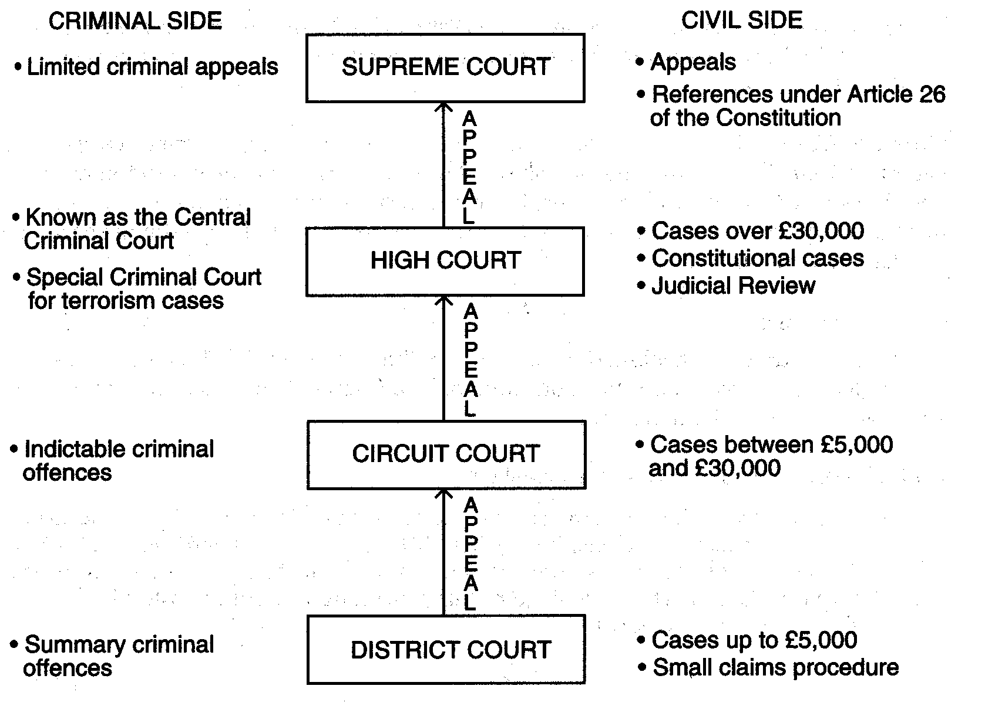
Court Structure

Slide 53
Benefits of Precedent
Consistency or Fairness
  Similar cases are treated in a similar manner,
  essential in a democracy.
Certainty
  Due to precedent, it is easier to predict the result of a case. This is of benefit to litigants and their legal advisors.
Saves Time
  Because most cases will be covered by an existing precedent.
  If there is no similar case, a judge will create a new precedent.
Realistic
  ‘forged on the anvil of reality’. (contrast to legislation)

Slide 54
Europe

Slide 55
European Union, Institutions, Law making and Judiciary
1952: European Coal and Steel Comm.
1993: European Union was established
  The Maastricht Treaty,
Within the European Union, there are in fact three Communities,
  European Community (EC) forms the bulk of the European Union.
  the ECSC
  and Euratom.

Slide 56
The Institutions of the European Union:
The Council of Ministers (different from the European Council, which has largely political significance),
The Commission,
The European Parliament,
The Court of Justice and the Court of Auditors.
www.europa.eu.int contains individual websites for each of these Institutions.

Slide 57
The Council of Ministers
is the highest decision-making and law-making body
Presidency of the Council rotates among members every six months, which lack of continuity can affect its effectiveness.
issues Regulations, Decisions and Directives, which are legally binding
Resolutions, Conclusions, Recommendations, and Opinions which are not legally binding
The European Parliament is consulted by the Council on proposals, and where co-decision procedure (introduced in Maastricht in 1992) is used for law-making
the Parliament has a right to veto (but usually secures amendments instead). Decision-making in the Council usually takes place on the basis of qualified majority voting.

Slide 58
European Commission
has extensive powers, and in particular the sole right to initiate legislation
in this manner that the Commission is the ‘government’ of the EU
divided into Directorates,
  e.g. Directorate of the Internal Market, and the Directorate of Justice and Social Affairs with regularity.

Slide 59
European Parliament
provides democratic legitimacy to the law-making process within the EU
It has no right to introduce legislation itself and limited powers to veto law-making by the EU in general
Recently, its 2005 referral to the European Court of Justice of the Commission-sponsored agreement with the US administration for the transfer of airline passenger data to the US could be seen as increasing value of the EP in the legal process.

Slide 60
European law
found principally in the EC Treaties (e.g. The Treaty of Rome and the Treaty on European Union (1992) i.e. The Maastricht Treaty),
in secondary EC legislation in the shape of Regulations, Directives and Decisions
in the rulings and decisions made by the European Court of Justice.

Slide 61
A Regulation applies in all Member States as law without need for further action.
Decisions are similar but binding only on 'those to whom they are addressed'.
Directives are binding in terms of implementation, but the form of implementation into domestic law is left to each Member State
although in the Francovich v. Italy case the European Court of Justice gave a citizen the right to damages where a Member State had failed to transpose a Directive into domestic law
Opinions, Recommendations, Resolutions and Declarations are not enforceable, but can guide the courts on the underlying purpose of Community law.
Of these Institutions, it is the Commission which hosts the most extensive materials relevant for law in the information society, although the other organs of the EU also make important contributions.

Slide 62
Example:
Look at Data Protection developments within the European Union, by looking at the Justice and Home Affairs directorate within the European Commission at
  http://europa.eu.int/comm/justice_home/fsj/privacy/
The Data Protection site can also be accessed from the Internal Market directorate site. This also has sections dedicated to Media in the Information Society, Intellectual Property, and Industrial Property at http://europa.eu.int/comm/internal_market/index_en.htm
The EU website also has a section on Communications developments at http://europa.eu.int/information_society/policy/ecomm/index_en.htm

Slide 63
Legislative process
normally initiated by the Commission
intimated to Parliament
and adopted by the Council of Ministers (or by the Council and Parliament)
Depending on the reaction of Parliament and/or the Council, the Commission has the option to alter its proposal. The Council and Parliament may each also request the Commission to submit proposals.
The role or participation of the Parliament in the legislative process depends on the legislative procedure being used by the Commission.

Slide 64
For Information Technology and Telecommunications law
it will either be offered a single reading for consultation and opinion only (Consultation procedure)
or it will be given a more prominent two readings together with a right of veto and ability to amend the proposal in cooperation with the Council (Co-decision procedure)
The Cooperation procedure involving Parliament in two readings for consultation and opinion only was abolished by the Treaty of Amsterdam, and the Assent procedure requiring Parliament’s agreement to a proposal but without the opportunity to amend that proposal has been restricted in its use by the Treaty of Amsterdam and is not relevant for current or future legislative proposals in the IT&T field.

Slide 65
Example
Look up any of the following Community legislative measures, and their background using the Parliamentary legislative search engine at http://www2.europarl.eu.int/oeil/index.jsp:
  EC Directive 95/46/EC (Data Protection) – search by Legislative Act Reference
  EC Directive 96/9 (Database Right)
  EC Directive 97/7 (Distance Selling)
  EC Directive 2001/29 (Copyright in Information Society)
  EC Directive 97/33/EC (Universal Service)
  EC proposal for a Directive COD/2002/0047 (Software Patents) – search by title “patent”

Slide 66
After a proposal is intimated to Parliament by the Commission, depending on the Treaty provisions being relied upon within the proposal, the agreement of the Parliament and Council, by either unanimity or a qualified majority is required before the legislative proposal is adopted.
Recommendations and Opinions have no binding force at all. These are therefore quasi-legal in their substance and only persuasive.

Slide 67
Directives
Implementation of Directives of the EC differs with each Directive.
Generally, a deadline for implementation by Member States is specified near the end of the Directive, and then infringement proceedings may subsequently be raised by the Commission against member states in default.
Example
  EC Directive 2000/31 (E-Commerce) was due to be implemented into national laws of Member States by 17 January 2002. It was implemented in Ireland partly by the Electronic Commerce 2000 and the remainder by the European Communities (Directive 2000/31/EC) Regulations 2003.

Slide 68
Direct effect
The Irish courts and other Member States’ national courts are obliged to apply Community law by virtue of direct effect
Whether or not they run contrary to domestic law, Treaty provisions and Regulations can have direct effect, thus allowing individuals of member states to rely on Community law to that extent in the national courts.
Directives can produce direct effect, thus allowing individuals to rely on their provisions before a national court, but only after the due date for implementation has passed. Individuals in these circumstances, may claim compensation based on a failure to implement the Directive but cannot claim against other individuals based on the Directive’s provisions.

Slide 69
The European Court of Justice
The European court system comprises
  the European Court of Justice (ECJ) – www.curia.eu.int - which decides matters which are referred to it by domestic courts within the European Union
  the European Court of Human Rights (ECHR) – www.echr.coe.int.
The ECJ ensures the observance of law in the interpretation and application of the EU Treaty and the provisions laid down by the competent Institutions.
There is also a Court of First Instance (CFI), since 1989, which deals with direct actions brought by natural and legal persons but which cannot give Preliminary Rulings (see below), and a Court of Auditors which oversees the implementation of the budget of the EU.
Procedure in the ECJ differs fundamentally from procedure in the domestic courts. First, it is important to note that there is no doctrine of stare decisis, or binding precedent. Any judgment is only binding on the parties to the dispute in question, and does not bind the ECJ when examining any future case.
the decisions of the ECJ are important reference points for interpreting issues of European Union law.

Slide 70
The relationship between the ECJ and national courts is dynamic.
In Ireland, The European Communities Act 1972, section 3(1), states that the decisions of the ECJ are binding precedent for the national courts.
Individuals can only raise proceedings in the ECJ to challenge decisions addressed to them specifically and which are of direct concern to them. The other source of individual interest in the proceedings of the ECJ is in terms of a Preliminary Reference under Article 234 – previously Article 177 of the EC Treaty. Here, a national court or tribunal refers to the ECJ a question of Community law which has arisen in the course of proceedings being determined before it. These can focus on the interpretation of Community law or the validity of Community law. The aim of a preliminary ruling is to ensure the uniform or consistent application of Community law in all Member States. The ECJ only rules on the question(s) of Community law which are referred to it, and it does not decide the case giving rise to the ECJ referral – instead, the case goes back to the national court for final determination. Nevertheless, the ECJ interpretation of Community law is binding on the national court which referred the matter to the ECJ, and any other court (e.g. a court of appeal) dealing with the same case.
The Treaty of Amsterdam changed the procedure for Preliminary References. For some matters (Title IV acts), only appeal courts can refer an issue. For other matters, any national court or tribunal can make a reference to the ECJ under Article 234.

Slide 71
Foundations of EU
Citizenship of the Union (Art. 8)
Free movement of goods (Arts. 9-37)
Agriculture (Arts 38-47)
Free movement of Persons (Arts. 48-51)
Right of Establishment (Arts. 52-8)
Free movement of Services (Arts. 59-66)
Free movement of Capital (Arts 67-73)

Slide 72
Policy of the EU
Rules on Competition (Arts 85-94)
Tax Provisions (Arts. 95-102)
Economic & Monetary policy (Art 102a-116)
Social Provisions (Arts 117-128)

Slide 73
Classification of Law

Slide 74
Common / Civilian systems
Civilian systems of law are based on principle and when addressing a problem, assess what to do in light of the legal principle that applies to that problem.
Common law systems are based on precedent and assess a problem by examining the decisions that previous courts reached in addressing analogous problems.
There are many mixed systems, including the legal system in Scotland.

Slide 75
Public law and Private law
Public law
  refers to the body of law, including local government law and constitutional law, criminal law which regulates the activities of the state vis a vis the private citizen
Private law
  refers to the body of law, which regulates the activities of individuals, often called black letter law. Includes:
  family law,
  law of succession,
  contract law,
  tort and
  law of property,

